Slide 1
Autonomous Flock Brush
By
Andrean januar 5115100029
Renaldi wahyudiono 5115100044
naufal Pranasetyo F 5115100057

Slide 2
Flock
Berdasarkan seni yang ide modelnya adalah kumpulan dari dari digital brush (flock).
Setiap flock merepresentasikan tiap bulu dalam kuas.
Untuk setiap brush stroke parameter termasuk bentuk, panjang, dan sudut stroke ditentukan oleh flock control parameter.
Parameter dalam flock control dapat dirubah dan menghasilkan gaya seni yang berbeda pula.

Slide 3
Preprocessing
Generate luminance map
Mengambil gambar berwarna sebagai input, lalu mengekstrak nilai RGB gambar, lalu memberikan nilai luminansi pada gambar dengan rumus dibawah :
Warna hijau memiliki nilai yang lebih besar karena retina mata manusia lebih sensitive dengan warna hijau.
Generate gradient map
Setelah langkah diatas selesai kita membuat gradient map. Map ini dibentuk dengan menggunakan sobel filter di setiap pixel dari gambar input.

Slide 4
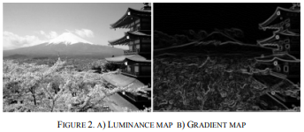

Slide 5
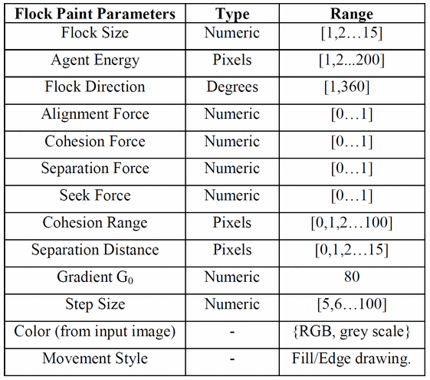
Control the Flock
Notes:
The flock size parameter controls the number of agents in the flock.
Alignment, cohesion, seeking and separation are classic steering forces that dictate inter-agent behavior as multiple agents move along a directed path.
Each agent also has an energy level to define how far the agent can move across the canvas. This energy level is a global parameter applied to all agents in the flock.
Flock direction controls the general heading of the flock.

Slide 6
Using the Flock
Flock draw
Navigate
Draw

Slide 7
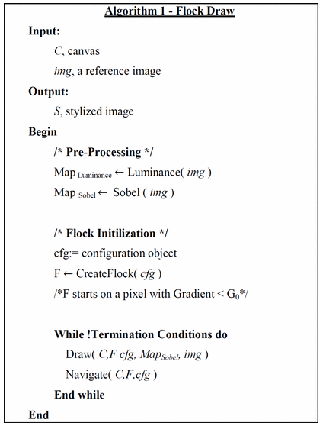
Flock draw
Notes:
The input image is a digital photograph; the area in which the flock moves is the canvas which represents the generated artwork. The size of the canvas is generally the same size as the input image, if not larger.
First, the user configures the flock parameters given in Table 1. The first flock is then set in motion. The system locates a start pixel with gradient value below threshold, Go. The flock brush is characterized by these parameters, flock size, steering force weights, separation distance and cohesion range. To begin, the flock brush is initiated and centered at the start pixel, i.e., refer to Fig. 4.

Slide 8
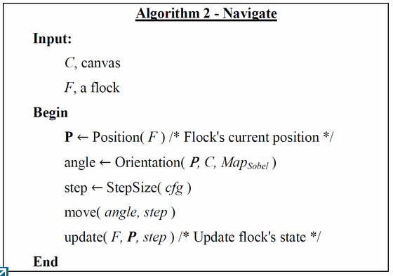
Navigate
Notes:
The next step is to determine the direction of travel for the flock brush, refer to Fig. 5. The direction can be defined by the user manually or determined by the image gradient at the starting pixel. The flock brush then proceeds to move in the chosen direction of interest. Brush strokes are thus imprinted incrementally as the flock moves about the canvas, see Fig. 6. The resultant form and shape of the stroke is determined by a combination of user specified parameters and flock forces.

Slide 9
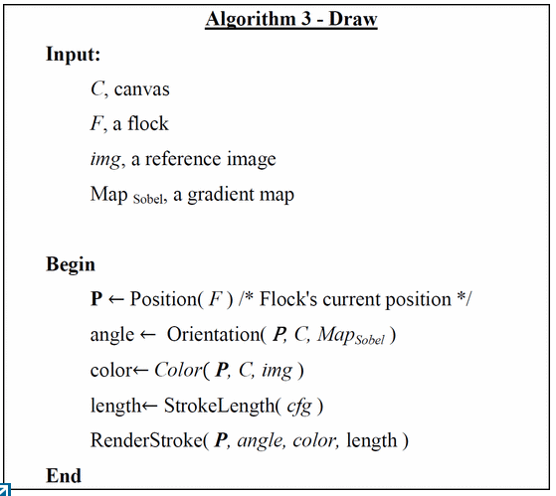
Draw
Notes:
The color of the stroke is sampled directly from the source image. So the resultant stroke share the same color as sampled at the flock's position.
The termination condition for the flock brush is met when the energy of the flock has been depleted or the edge trail vanishes. After one flock terminates another will be created for the next stroke. The above process iterates and complete until the pre-defined number of strokes to create is fulfilled.
The shape of the stroke is defined by the steering forces. As the agents move in a flock, the steering forces may cause agents to overlay with another agent's path resulting in strokes that are non straight lines. Since artists in general do not draw or paint with rulers but instead uses a free-hand approach, this feature of the flock brush aids in creating a “free-hand” look.
Real-life painters are also unable to paint continuously without refilling paint, so to simulate this nuance the color intensity of a stroke is set inversely proportional to the length of the stroke.

Slide 10


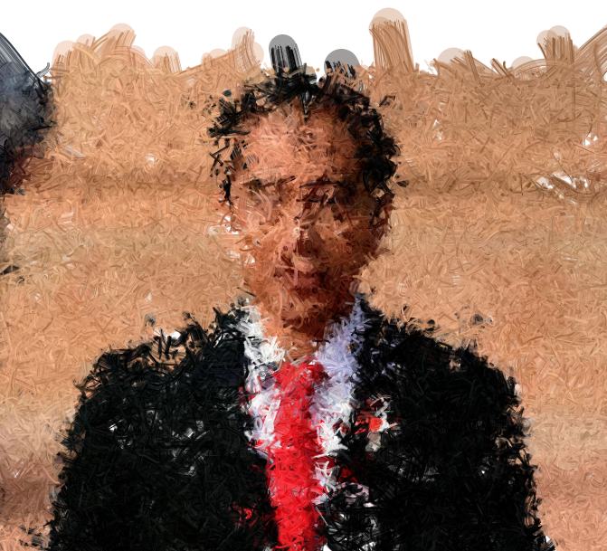



Contoh sementara

